Slide 1
Texture
Patrick Kevorkian

Slide 2
Topics
Box- Counting Dimension Method
Local Binary Patterns
First Order Statistics
Grey level Co-Occurrence Matrix
Haralick Texture extraction

Slide 3
Goals
Understand the previous topics
Implement these topics
Demonstrate them
Any topic not understood, do best to do so

Slide 4
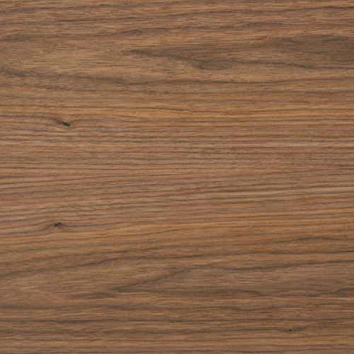
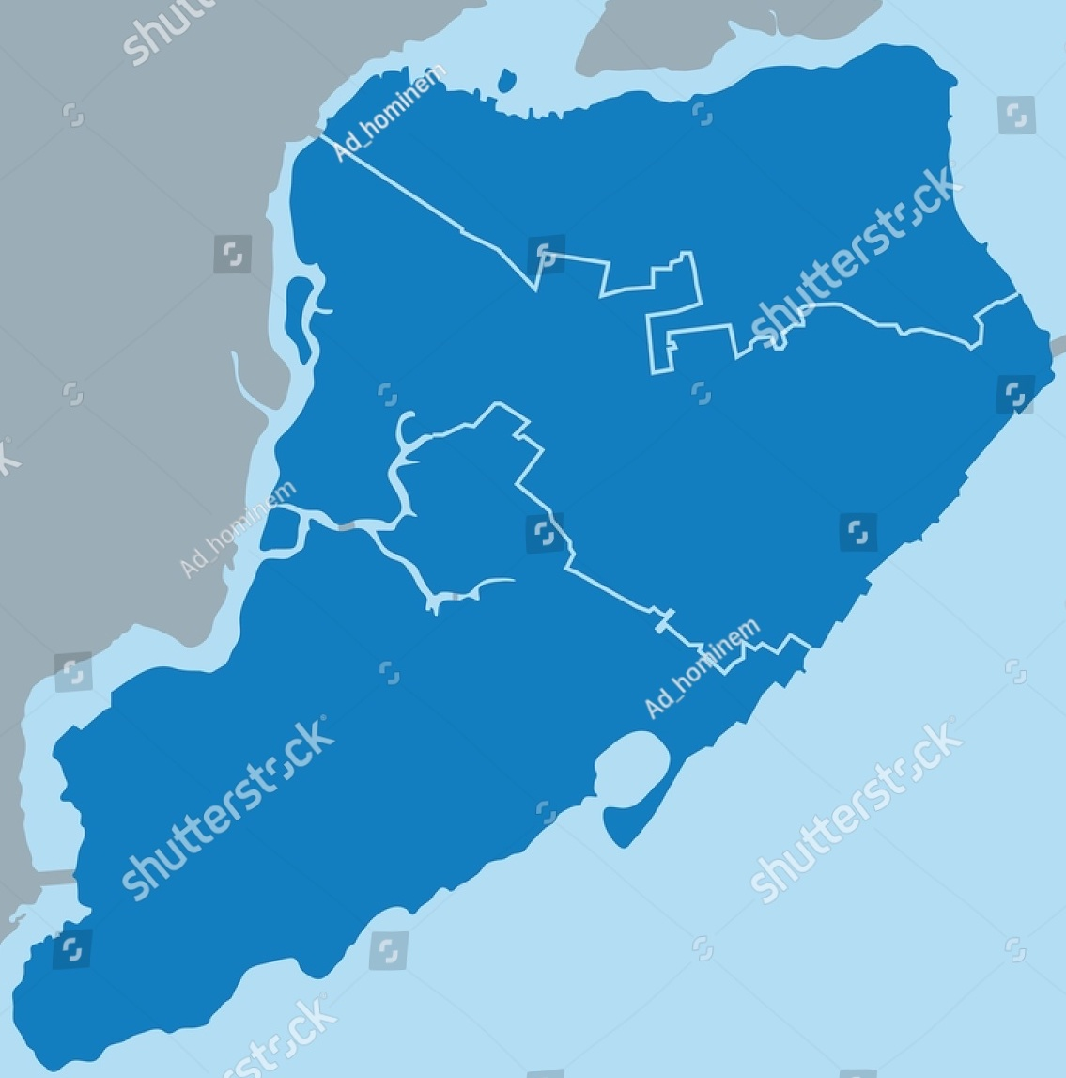
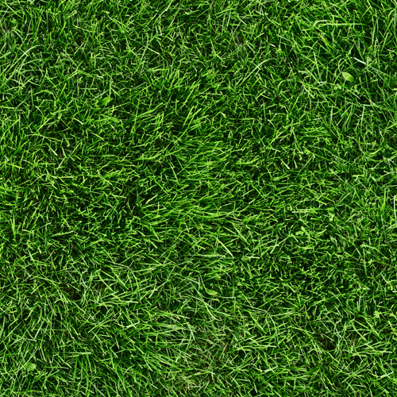
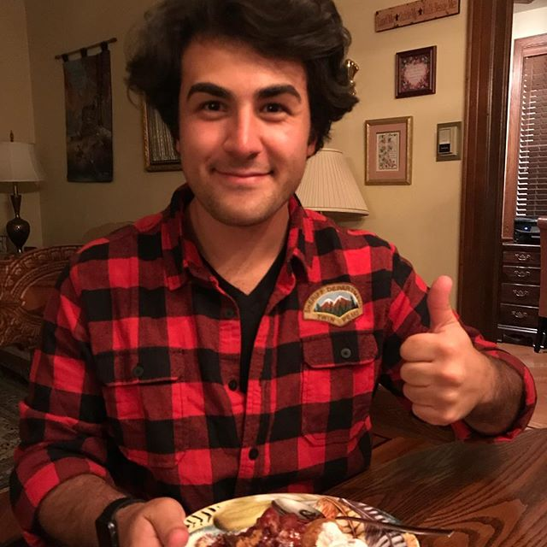
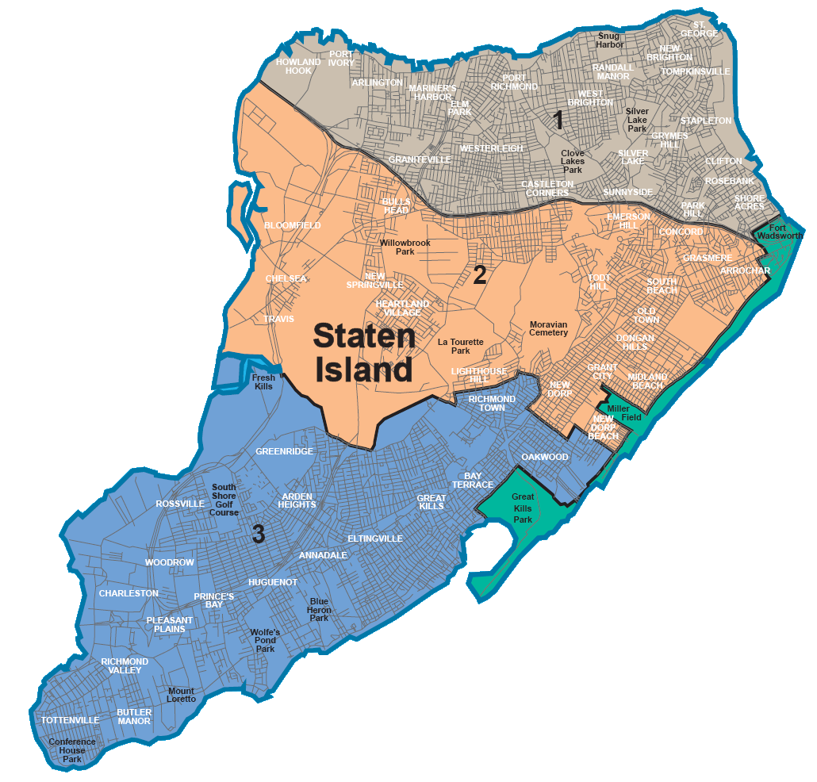
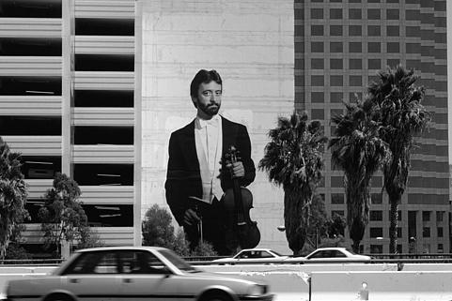
Review: original images

Slide 5
Box counting
code by me
Uses combination of threshold, sobel edge detection and median filter
Each case is particular
Fractal dimension calculation
Box size vs number of boxes containing contour
Coast of Staten Island?

Slide 6
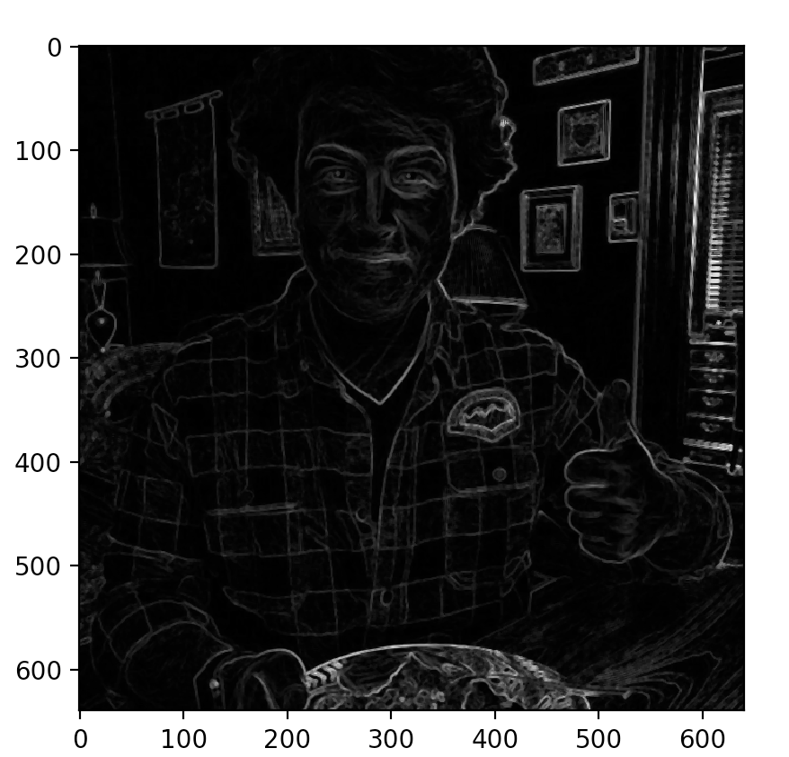
Example 1: me

Slide 7
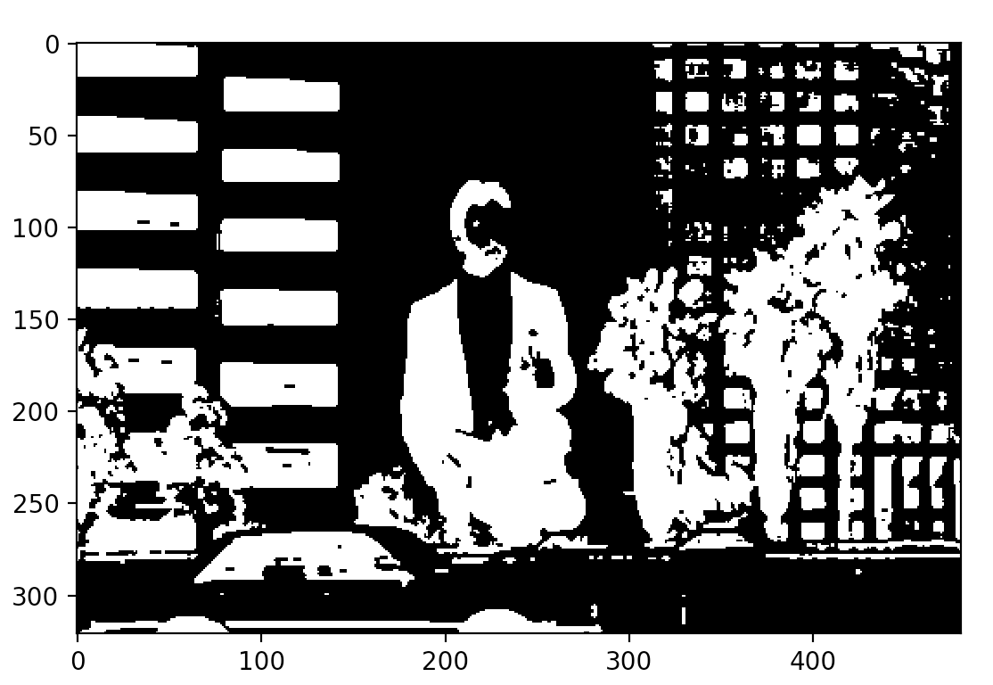
Example 2: Berk

Slide 8
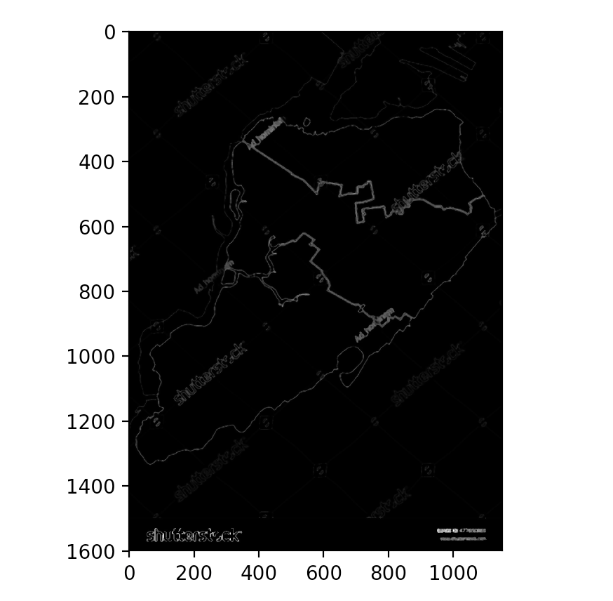
Example 3: SI 1

Slide 9
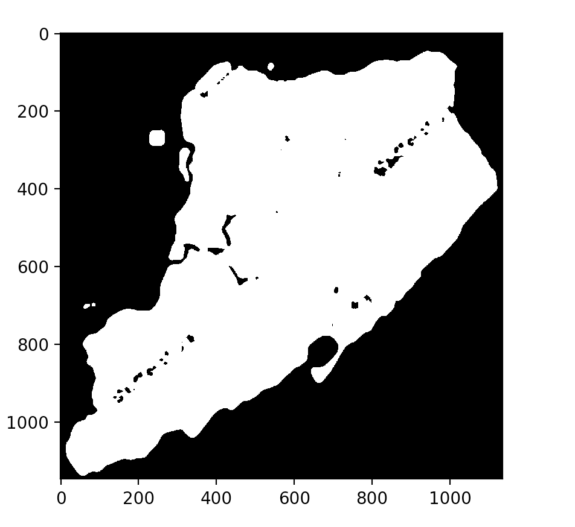
Example 4: SI 2

Slide 10
Local Binary patterns
Code By me And Mathworks
Texture operator
Thresholding neighboring pixels
Result a binary number
Good for comparing textures
Facal recognition
Histograms

Slide 11
Example 1: Wood and Grass

Slide 12
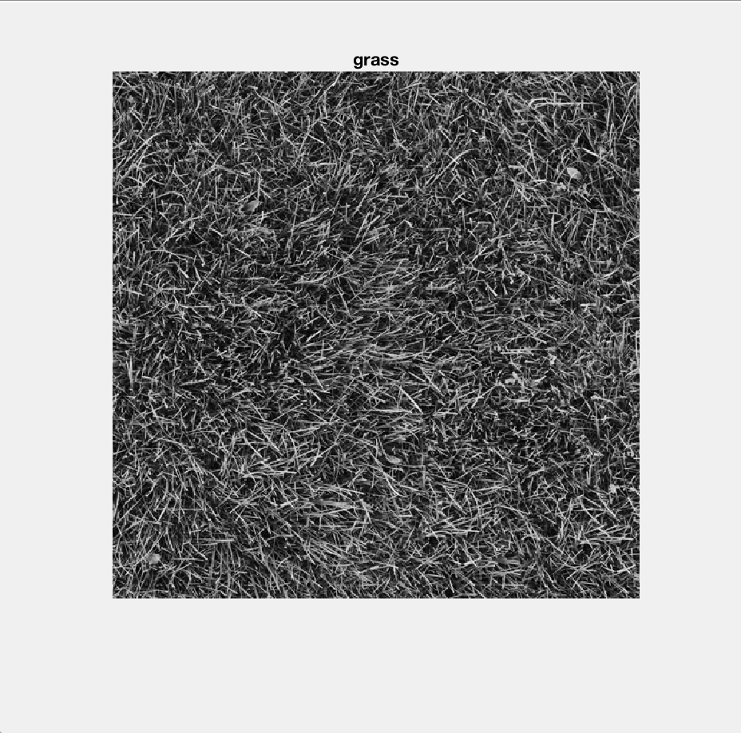
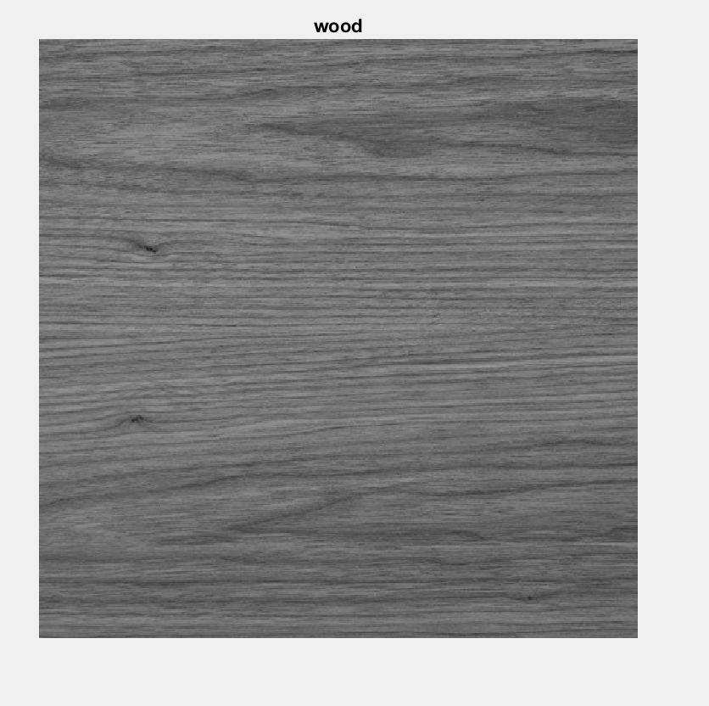

Slide 13
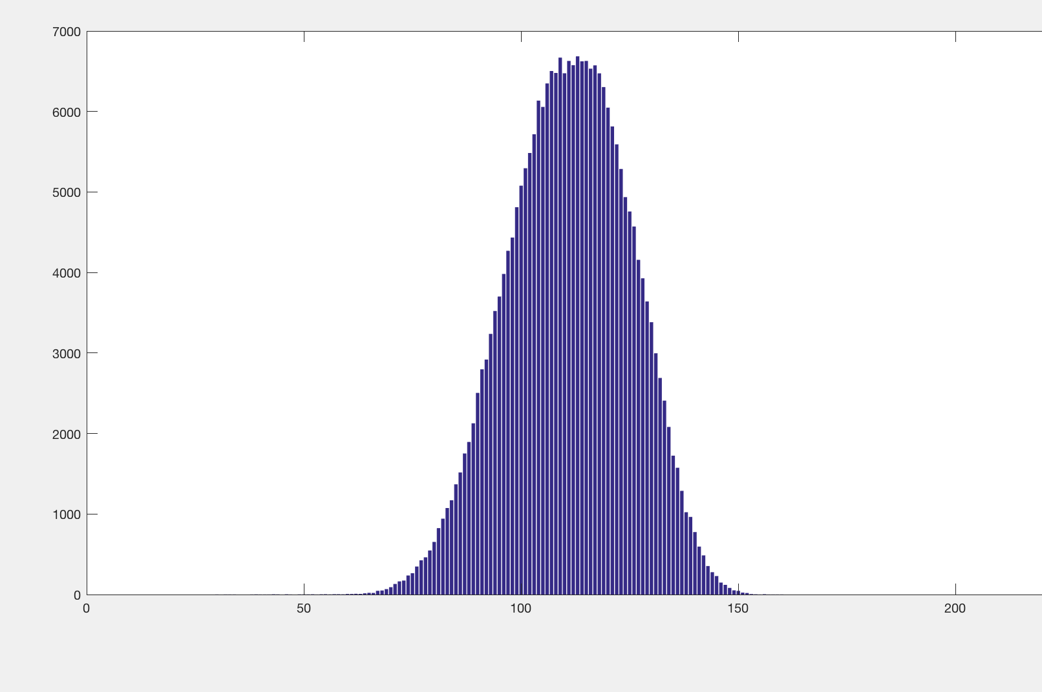
original wood hist

Slide 14
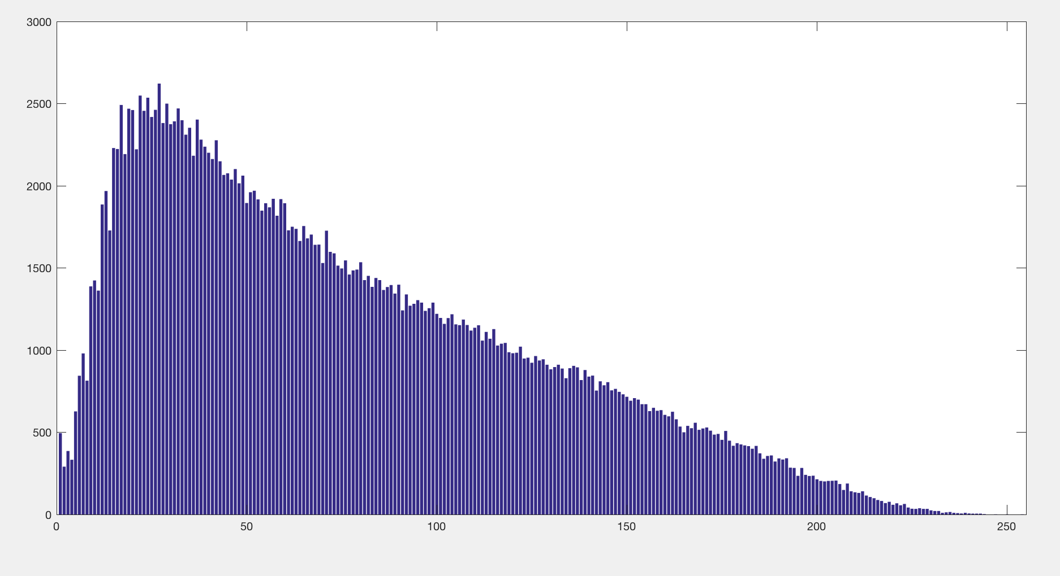
original Grass Hist

Slide 15
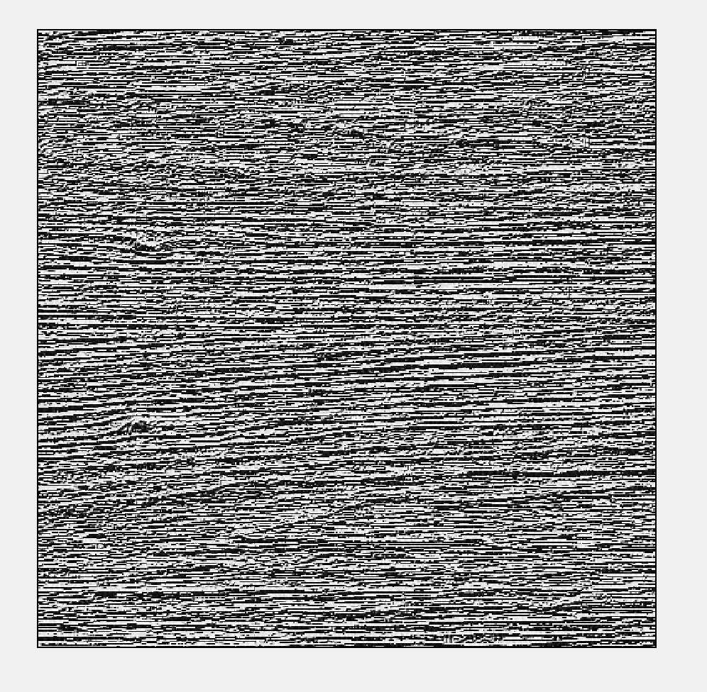
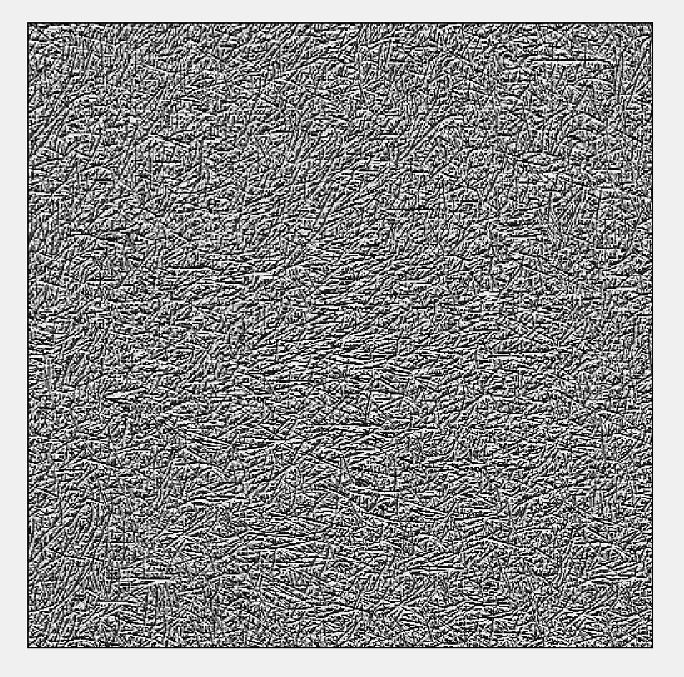

Slide 16
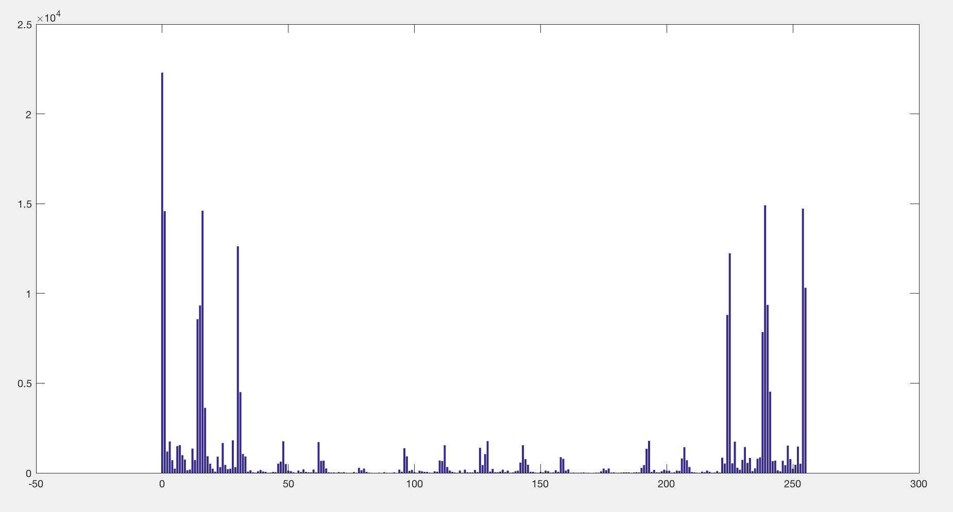
New Wood Hist

Slide 17
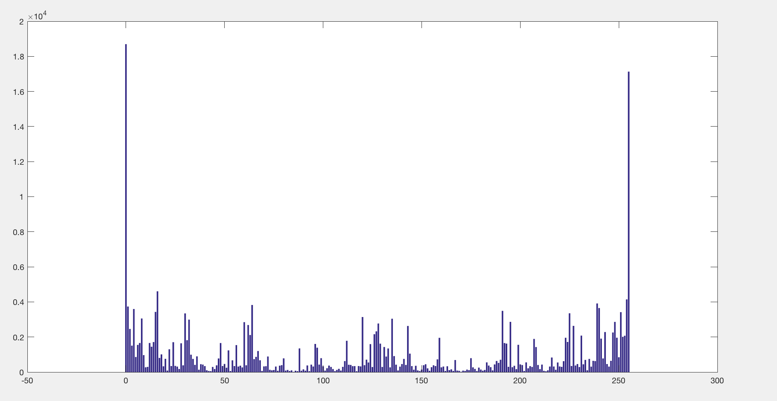
New grass hist

Slide 18
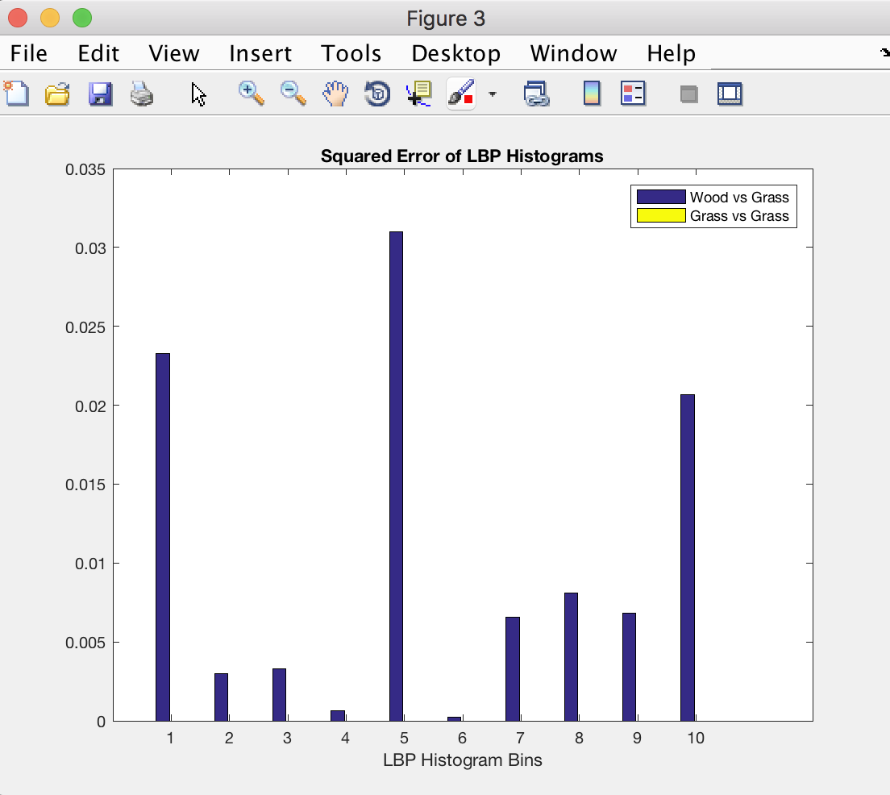

Slide 19
First order statistics
code by me
Grey level distribution
One pixel
Mean gray value
Deviation of grey values
Coefficient of variation

Slide 20
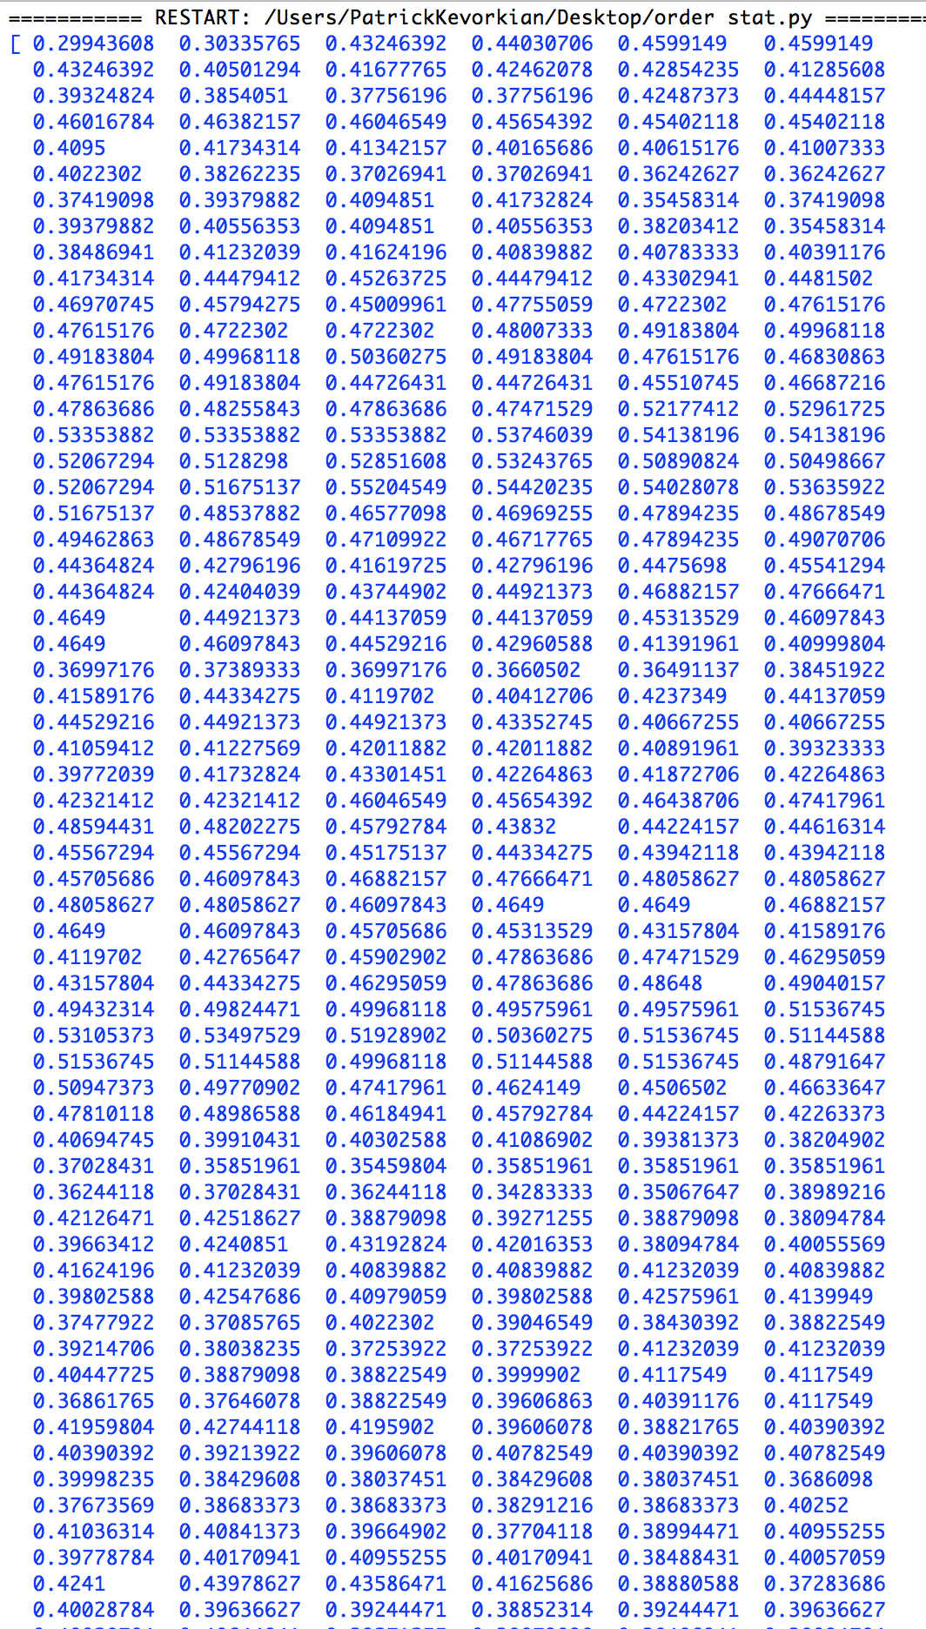
Exapmle 1: wood

Slide 21
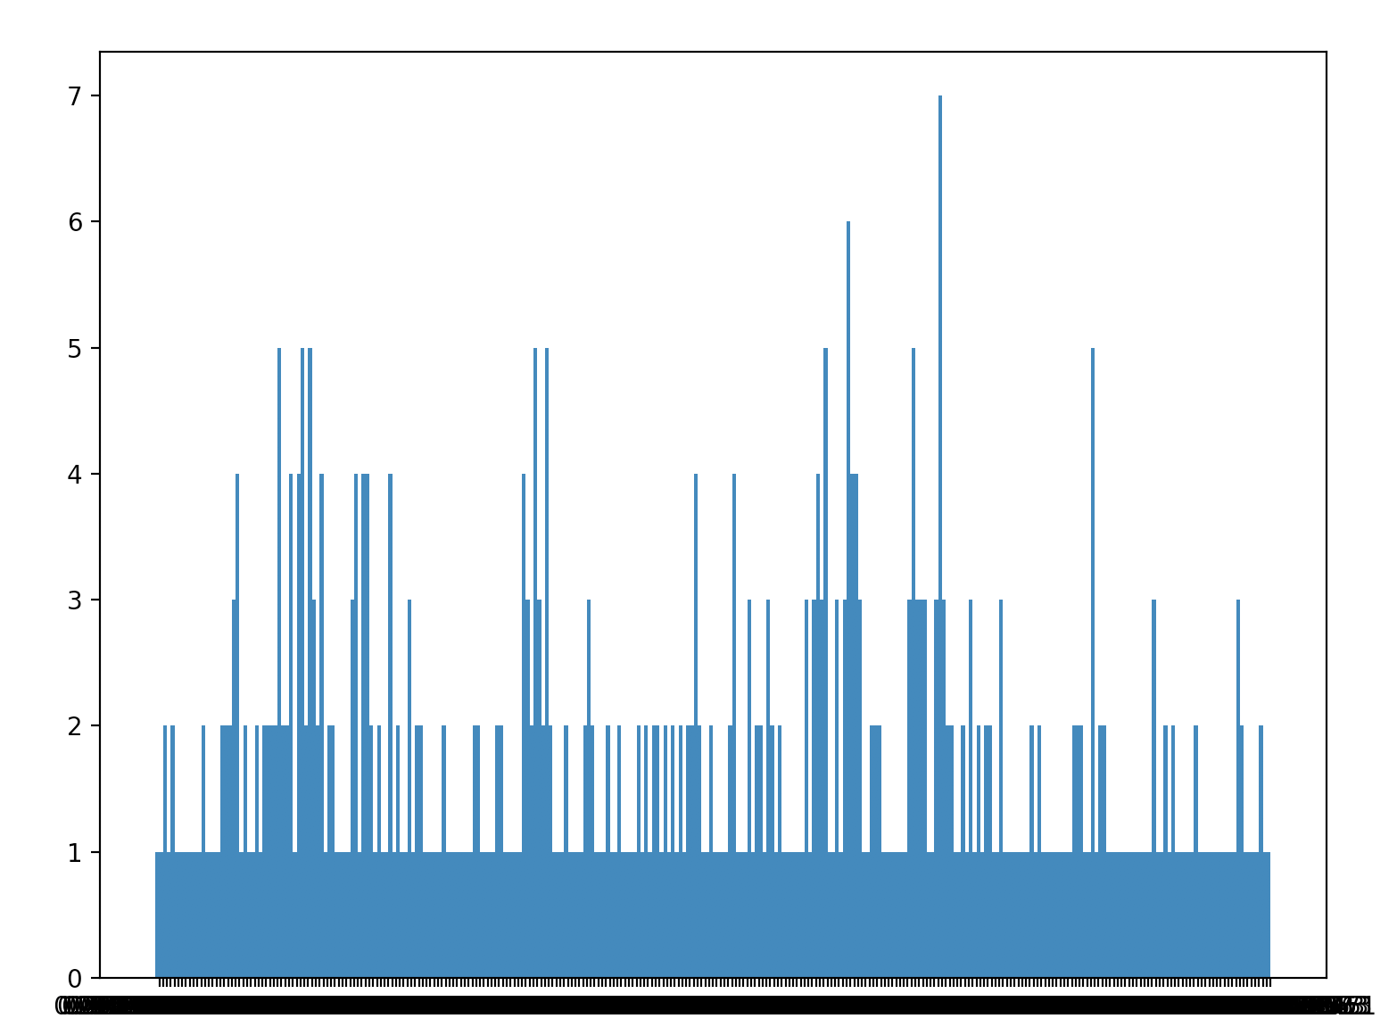

Slide 22
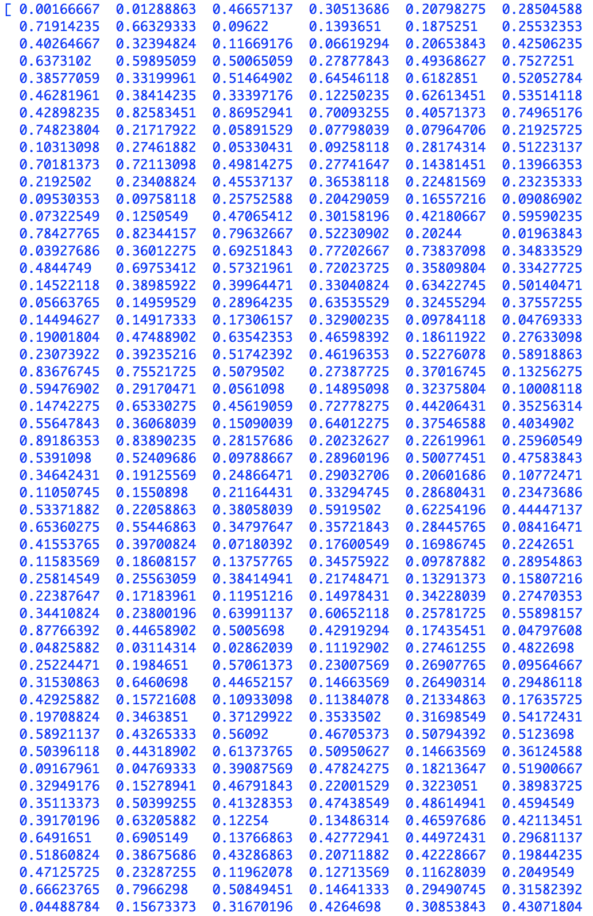
example 2:grass

Slide 23
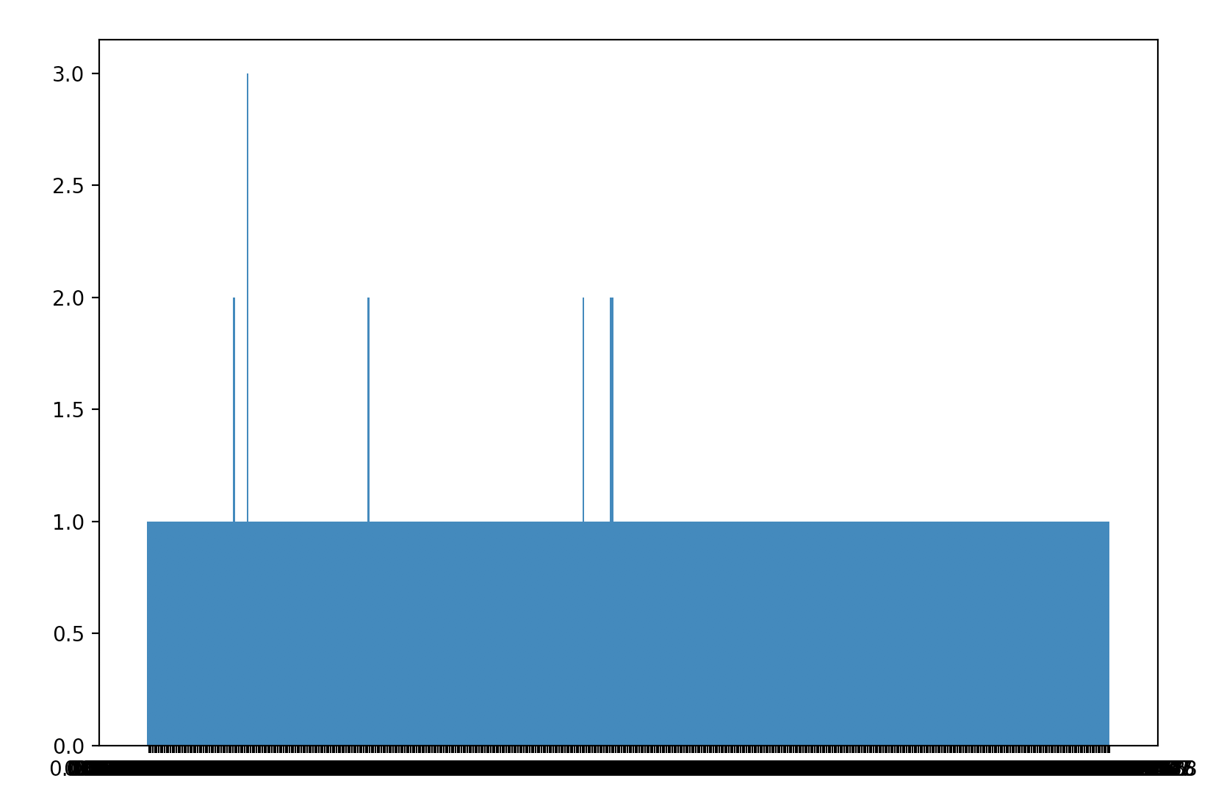

Slide 24
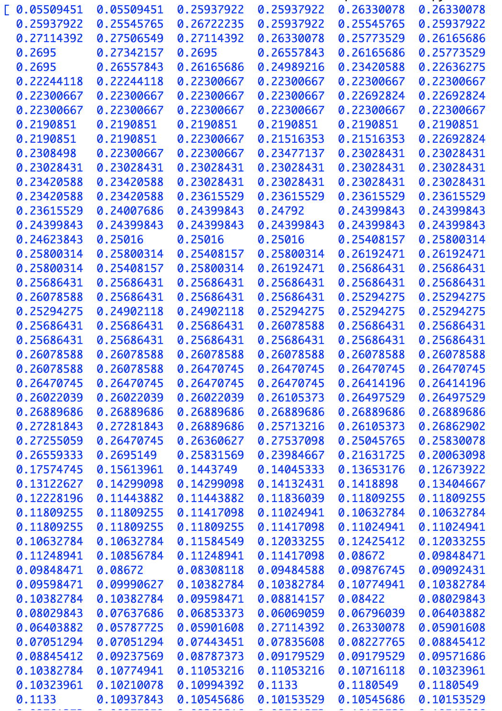
Example 3: ME

Slide 25
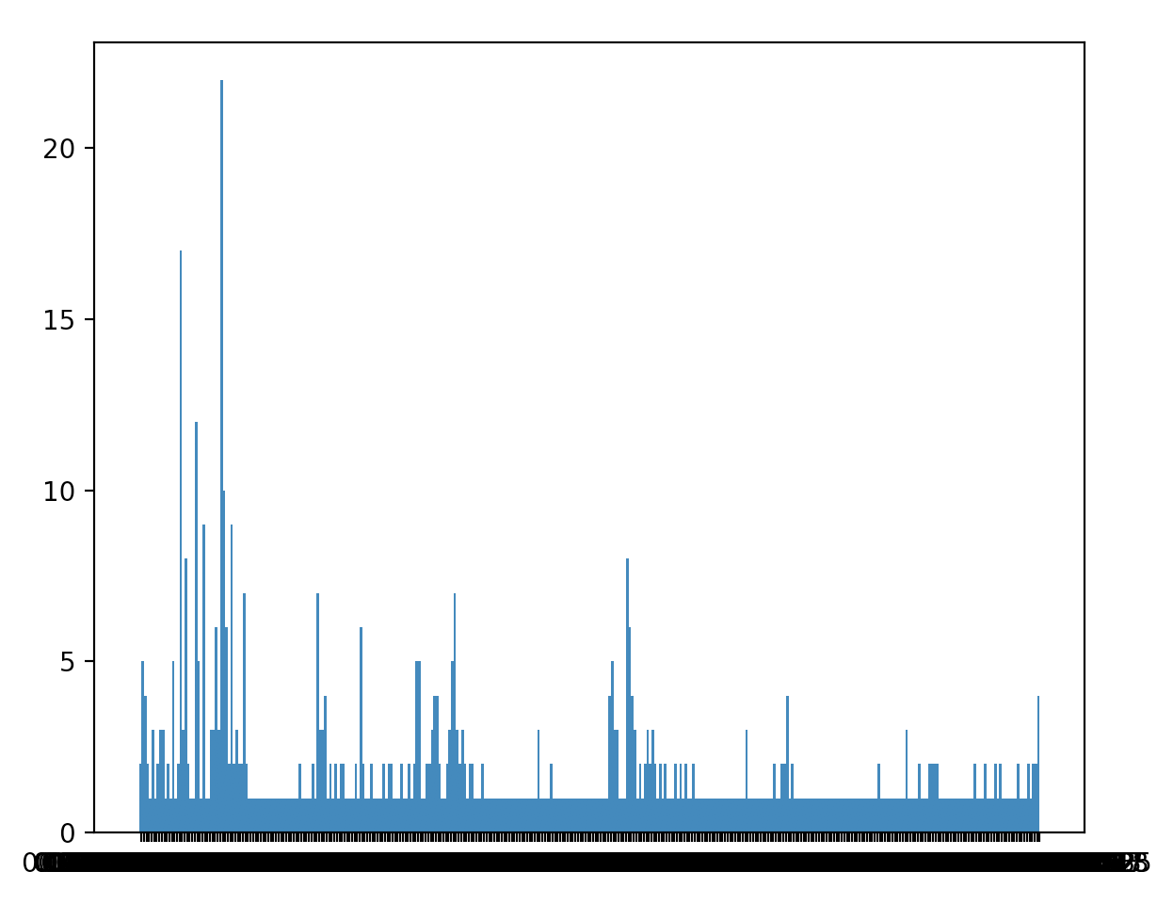

Slide 26
Grey level Co-occurence Matrix
code by mathwork
Paired grey level probabilities
Two pixels separated by a certain vector appear in the image
Matrix of frequencies
Also done in terms of distance
Many parameters, computationally expensive
Bad for course textures, noise

Slide 27
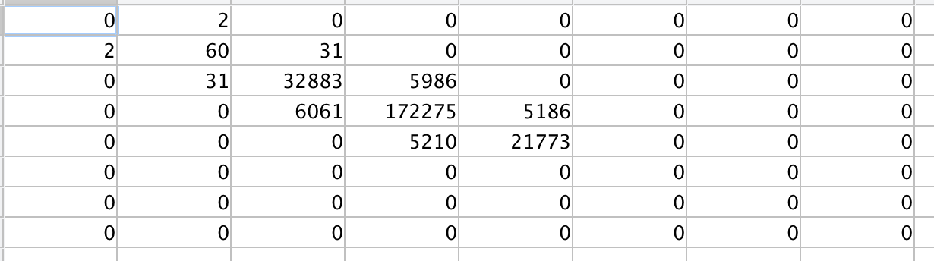
Example 1: wood

Slide 28
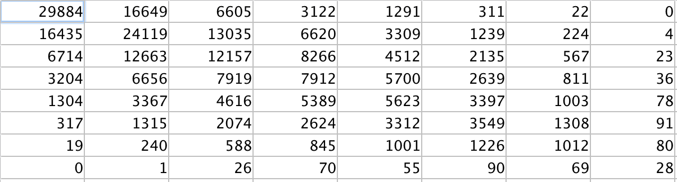
Example 2: Grass

Slide 29
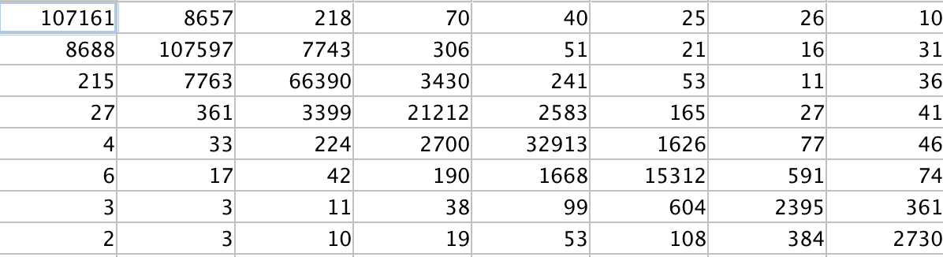
Example 3: me

Slide 30
Haralick Texture features
Code: me, mathworks, online source
Difference between adjacent pixels
14 features!
Calculated from co-occurrence matrix
Correlation in intensity in space
Correlation in intensity in time
Please note applying these features to original image was a shorting
I however was able to calculate them

Slide 31
Features
Energy
Contrast
Correlation
Variance
Inverse difference moment
Sum Average
Sum Variance

Slide 32
Sum Entropy
Difference Variance
Difference Entropy
Information Measure of Correlation I
Information Measure of Correlation II
Maximal Correlation Coefficient

Slide 33
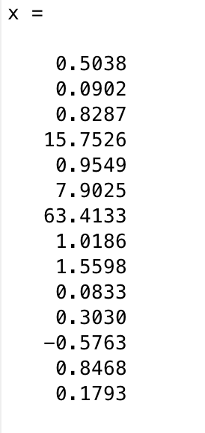
Example 1: Wood

Slide 34
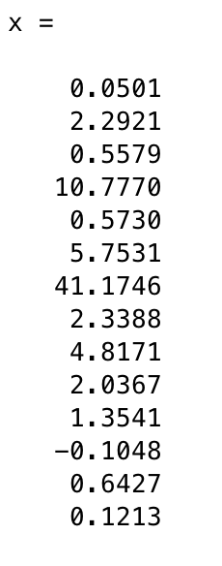
Example 2: grass

Slide 35
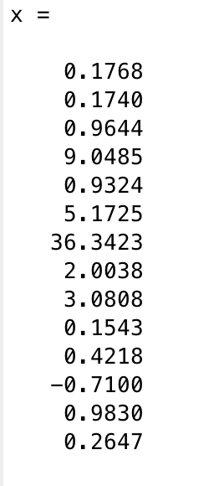
Example 3: me

Slide 36
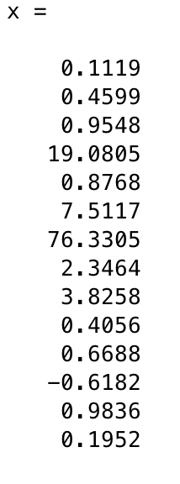
Example 4: Berk

Slide 37
Conclusions
Textures is very deep area of study
There are ever evolving areas of application
Topics covered today are integral parts of this evolution
I would like to follow up on my shortcoming from this topic
There are limitations to current techniques
But good results appear when method is finely tuned

Slide 38
Thank you

